Slide 1
Web Scraping Method Website: SAM.gov Tools: Python, VS CODE
Team Amplytics
UC Davis 2025
Jenny, Henri, Rebecca, Sonia, Alex

Slide 2
Table of contents
Part 1. Retrieving data by sending an API call.
Part 2. Web scraping using Selenium and Beautiful Soup
Part 3. Upload data to Supabase by sending an API call
Brief introduction of code
The entire script is divided into three main parts. In the top part, I defined the functions necessary for installing the Chrome browser, sending an API call, retrieving specific details of each RFP and uploading the complete data to Supabase. On the bottom part, I specified the logic for executing the script, including keywords insertion and data iterations for consecutive data extractions from the web page and uploads to Supabase. Therefore, you can better understand the code by reviewing it starting from the bottom and moving back and forth to find how the functions interact with the main execution rather than reviewing it sequentially.

Slide 3
Part 1. Retrieving data by sending an API call.

Slide 4
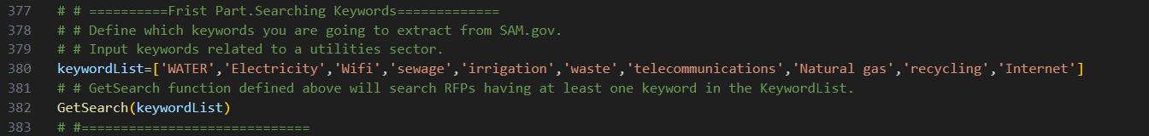
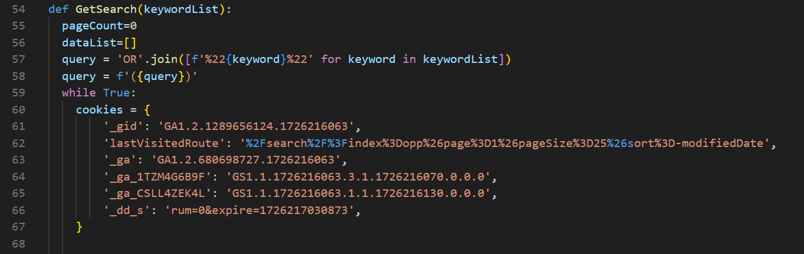
Define keywords you want to search for on SAM.gov in the ‘keywordList’
Scroll up to find a ‘GetSearch’ function defined above.
You can find a ‘GetSearch’ function where it sends HTTP GET request to the server.
Here, I sent a HTTP GET request to Search API endpoint to get search data using keywords listed in the KeywordList. This process starts when accessing ‘Advanced search’ and adding keywords in a Search Editor to extract RFPs details before clicking a specific document.
Starting from the 1st page of the search results and then increment the page number.
Making an empty list, I will add ‘data’ dictionaries into the list.

Slide 5
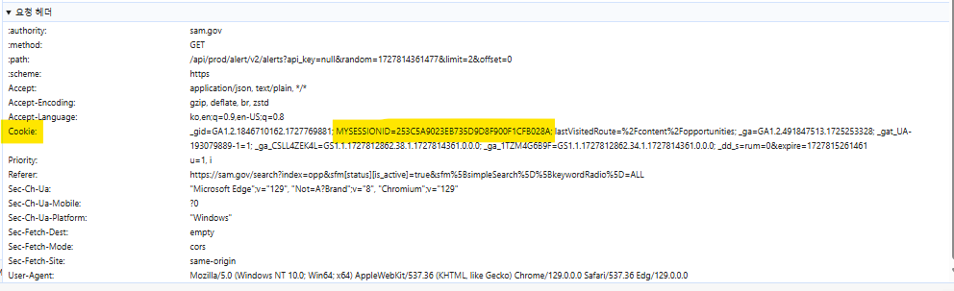
Using ‘GetSearch’ function to send HTTP GET request to Search API endpoint of the server.
In the first query, if the keywords are water and electricity, it will be joined as “Water”OR”Electricity”. And in the 2nd query, it is created as ("Water"OR"Electricity“)
We can find ‘cookie’ data in ‘DevTools’. The ‘cookie’ data usually involves session data for users. However, SAM.gov possesses public data so I did not include MYSESSIONID info in the ‘cookie’.
You can find ‘cookie’ data in a ‘Request Header’.

Slide 6
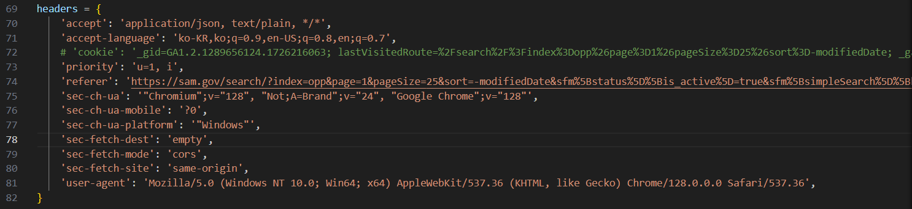
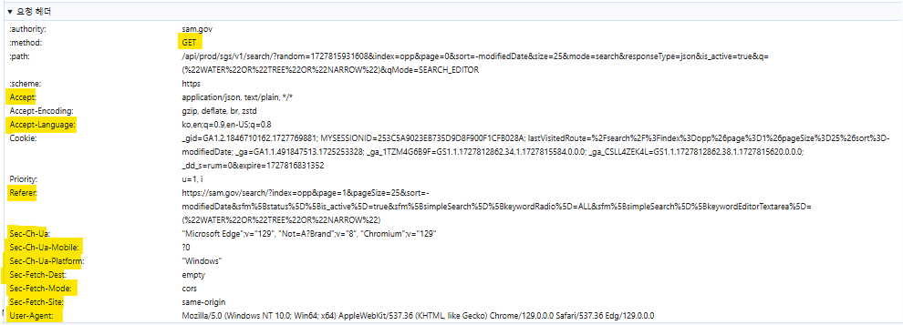
I need to send ‘headers’ information to the server when sending HTTP GET request to Search API.

Slide 7
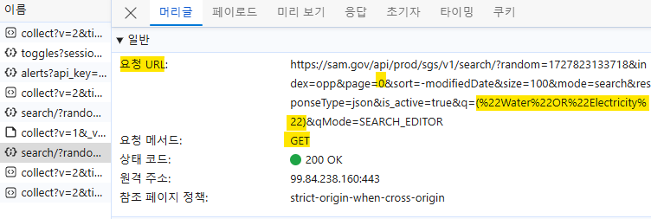
Sending GET request to the API endpoint and saving the response in a ‘response’ object with cookies, headers, search query and page number.
This is the ‘request URL’ with page number and search query.
I found this ‘request URL’ in the header of a ‘DevTools’.
In the image below, I am on the 1st page and I search keywords like (“Water”OR”Electricity”)
Header
Request URL:
When I sent the HTTP GET request with the Request, I had to dynamically change the page number and keyword query.
Therefore, I used {} to indicate a placeholder where dynamic values must be included.
Request
Method:

Slide 8
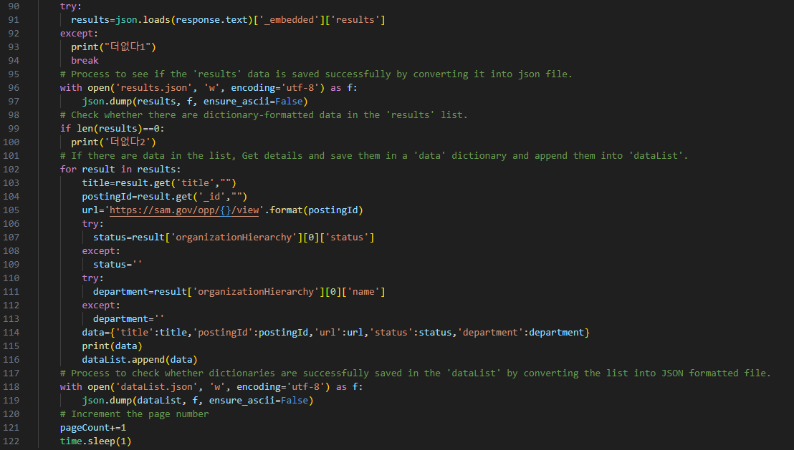
After sending the HTTP Get request, the server will send a response back in JSON-
formatting. The outcome was saved in ‘Response’ object. However, the JSON format is not
Python friendly so I changed it to a dictionary format using the ‘json.loads’ function.
Therefore, ‘Response’ object is JSON-Formatted data, converted into
JSON text data (‘response.text’) and then finally converted into a Python friendly dictionary.
I only extracted the ‘results’ key from the ‘response’ data, converted into a dictionary using ‘json.loads’ function.

Slide 9

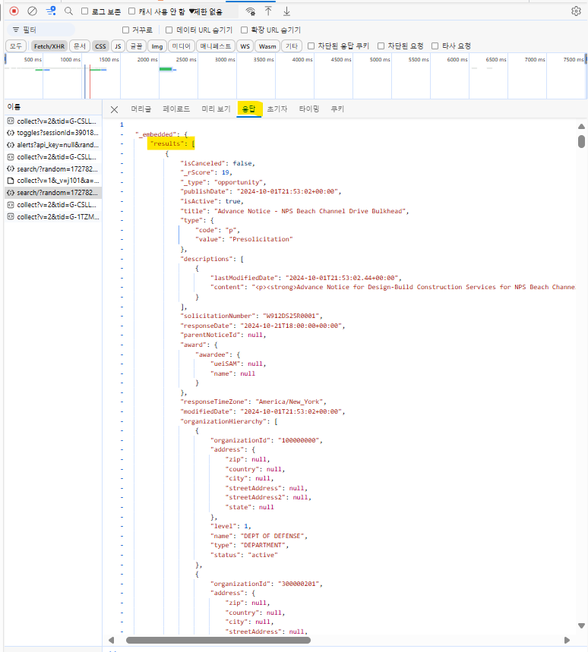
Response
If the ‘response’ data is not parsed correctly, the loop will stop.
JSON-Formatted data.
And ‘results’ is one of the keys in a dictionary, and its value is a list containing sub-dictionaries.

Slide 10
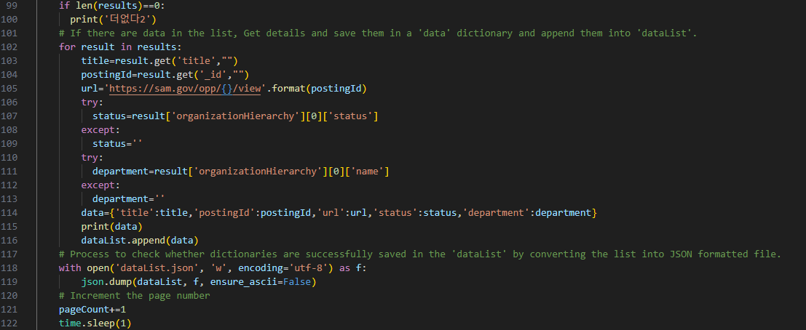
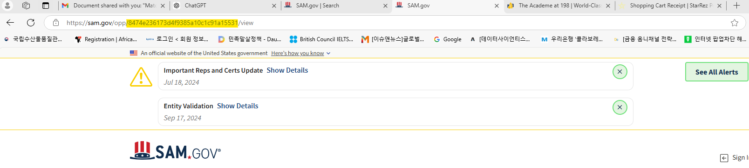
If there are no more pages, the loop will stop and print “더없다2’
1. There are sub-dictionaries stored in the ‘results’ list.
2. I extracted keys, such as ‘title’, ‘_id’, ‘status’ and ‘department name’ from a sub-dictionary.
3. And store them in a ‘data’ list.
4. I repeatedly implemented the same process for the rest of the sub-dictionaries included in the ‘results’ object.
5. Finally, I appended all the ‘data’ dictionaries into the ‘dataList’ that I created above.
Page is incremented whenever the loop is ongoing.
When I click a document, the URL format is url='https://sam.gov/opp/{}/view’. In {}, the postingID, which is an identifier of each RFP, must be included.
I dynamically added the ID info using format function.

Slide 11
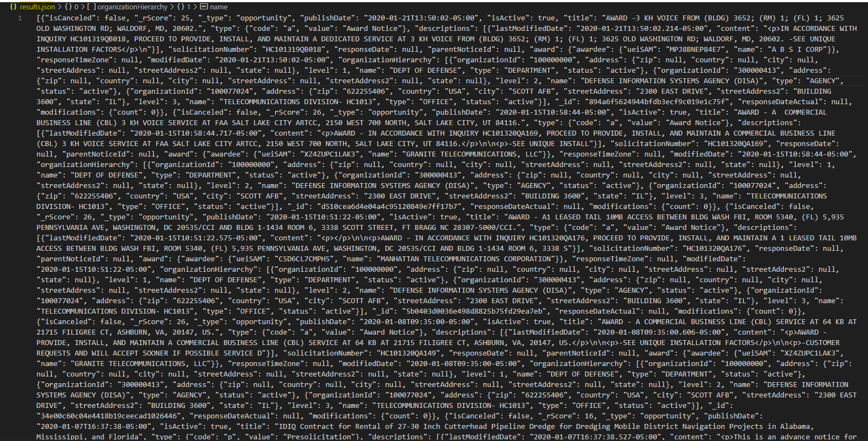
The result of ‘result.json’ file.

Slide 12
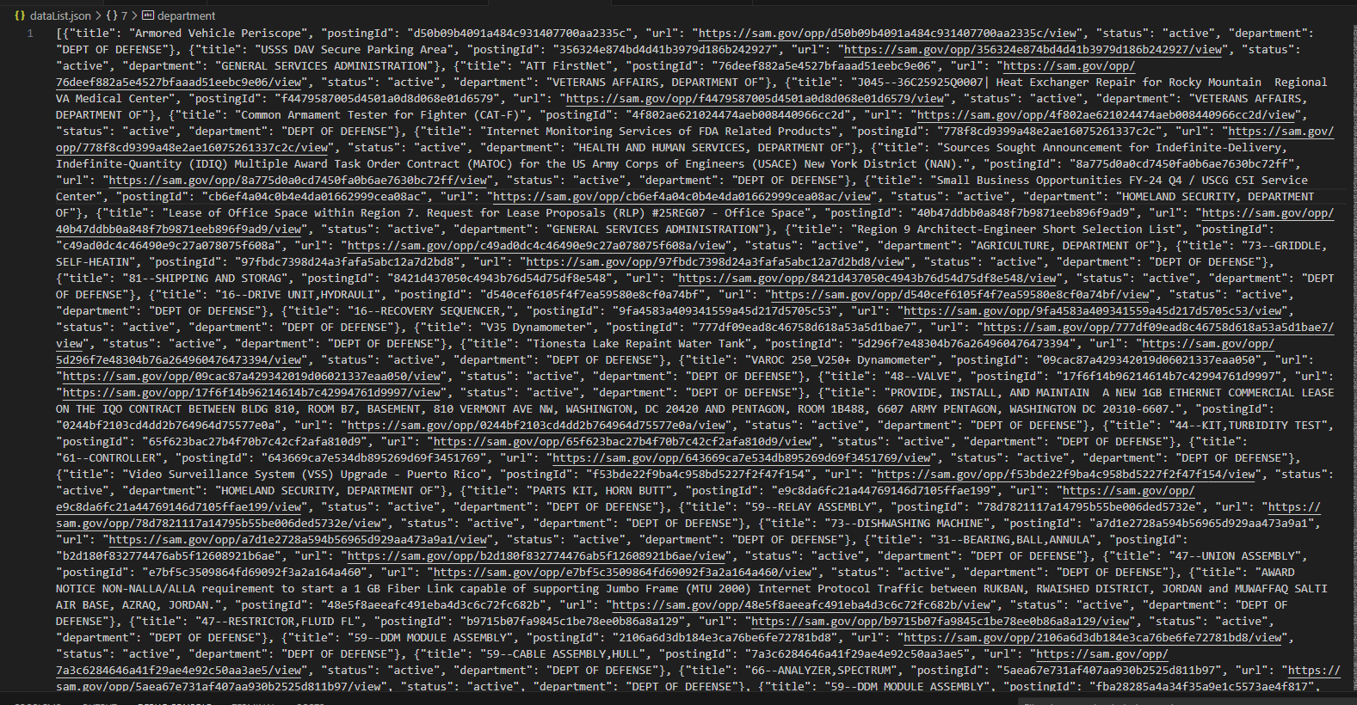
The result of ‘result.json’ file.

Slide 13
Part 2. Web scraping using Selenium and Beautiful Soup.

Slide 14
Now we are going to extract specific details from each RFP!
We have already searched RFPs above and saved them into a ‘dataList’ and then converted them into a JSON file.
From this line, I am going to extract specific details of RFPs.
In order to further process it in Python, I need to convert the dataList in the JSON file format back into a Python ‘List’ using the ‘json.load’ function.
For your reference, ‘r’ means I am going to open the ‘dataList’ file in read mode using ‘f’ file object.
The function of the ‘f’ object is helping Python connect with the opened file. When the file opens, Python uses the ‘f’ file object to read from it.
The ‘encoding=utf-8’ helps Python read from and write to text files, managing various languages including English, Korean, Chinese and so on.

Slide 15
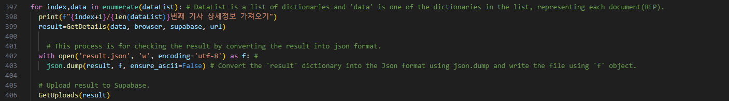
We have already opened the ‘dataList’ file, and partial data extracted via an API call are stored.
The for loop iterates over data and retrieves the complete dataset using the ‘GetDetails’ function that is used when web scraping data using Selenium and bs4.
After extracting the full dataset combining partial data with the web scraping data, we store them in the ‘result’ object and convert it into a JSON file.
The result will be uploaded to Supabase by using the ‘GetUpload’ function in Python.

Slide 16
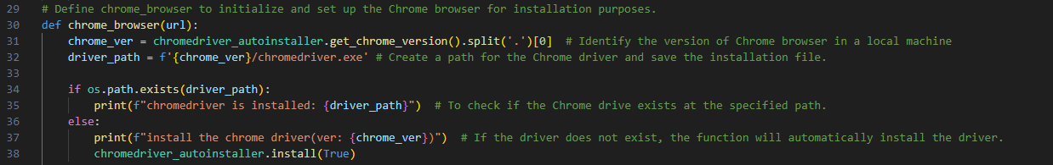
1. I made an empty list to combine the results of ‘dataList’, obtained by API call sending HTTP GET request to the Search API endpoint of the server with additional information obtained by Web scraping using Selenium’s ‘GetDetails’ function.
2. I opened the Chrome browser using the ‘browser’ object, already defined above. Now, I am going to explain how to install ChromeDriver, which helps Selenium interact with Chrome browser in your local computer.
Define the ‘chrome_browser’ function and set up all configurations for the Chrome browser.
‘chromedriver_autoinstaller’ function will get the version of Chrome installed in your local machine automatically and will index the major version.
We need a Chrome Driver to control the Chrome browser and helps Selenium interact with the browser.
After designating the path for ‘chromedriver.exe’ installation file, the ‘if’ code checks whether the Chrome Driver already exists at the specified path.
If not, ‘chromedriver_autoinstaller’ installs the Chrome Driver automatically that matches the version of Chrome installed in my local computer.
For instance, if the major version of Chrome installed is 95, the Chrome driver that matches the version of 95 is automatically installed.

Slide 17
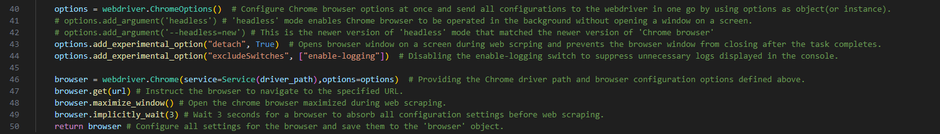
Configure all necessary settings for Chrome browser that we are going to control using Chrome Driver using a ‘ChromeOptions’ function in a ‘webdriver’ library in Selenium.
All configurations will be saved in ‘options’ object.
‘add_experimental_option’ function sets up the Chrome browser opened on a screen during web scraping.(“detach”, True)
This function also disables ‘enable-logging’ switch to suppress unnecessary logs displayed in the VS CODE console when opening the Chrome browser.
After setting up the configurations, we provide the path for Chrome driver and all setting options to ‘browser’ object using ‘Chrome’ function in ‘webdriver’ library.
‘browser’ also configures settings for itself, such as navigating to the specified URL, maximizing the window screen size during web scraping and waiting for 3 seconds for the web page being loaded.
All these settings will be saved into ‘browser’ object and then returned back.
The ‘browser’ object is used when assigning a specific URL for web scraping.

Slide 18
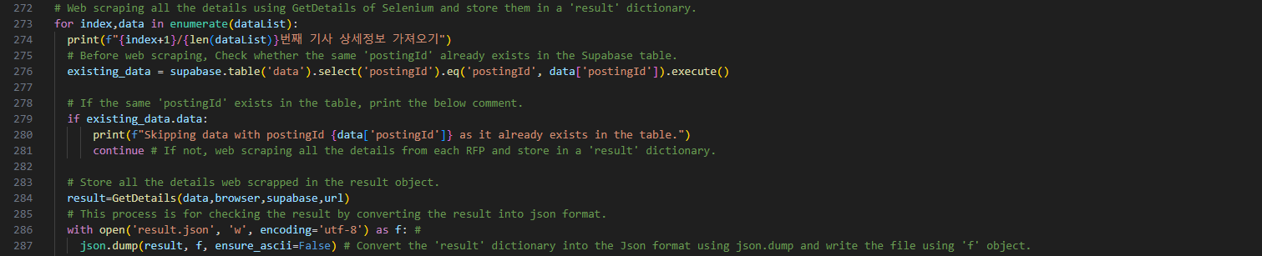
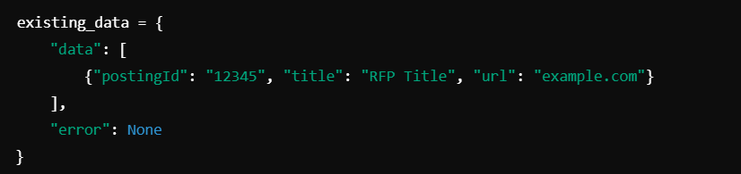
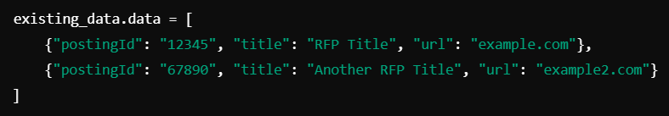
‘enumerate’ function retrieves ‘index’ and ‘data’ dictionary in ‘dataList’ whose data we got from the server by API call.
And then print ‘index+1’ / the total number of data in dataList to indicate which RFP is currently being retrieved by web scraping.
‘existing_data’ object will check whether the ‘postingId’ obtained by API call matches the one uploaded in a Supabase table.
(Below images for references) ‘existing_data’ retrieves data from the Supabase as a list, and there is ‘data’ key with ‘postingID’ of each RFP.
If the ‘postingId’ uploaded in Supabase matches the ‘postingId’ extracted from the server, it will skip the RFP.
If not, the code will continue and get details from the server by web scraping and store all the details in ‘result’ as a dictionary.

Slide 19
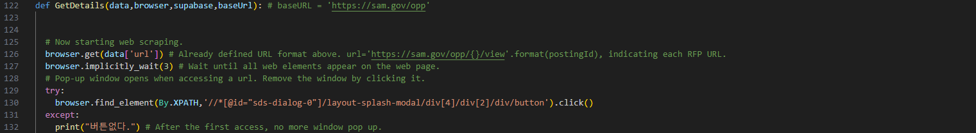
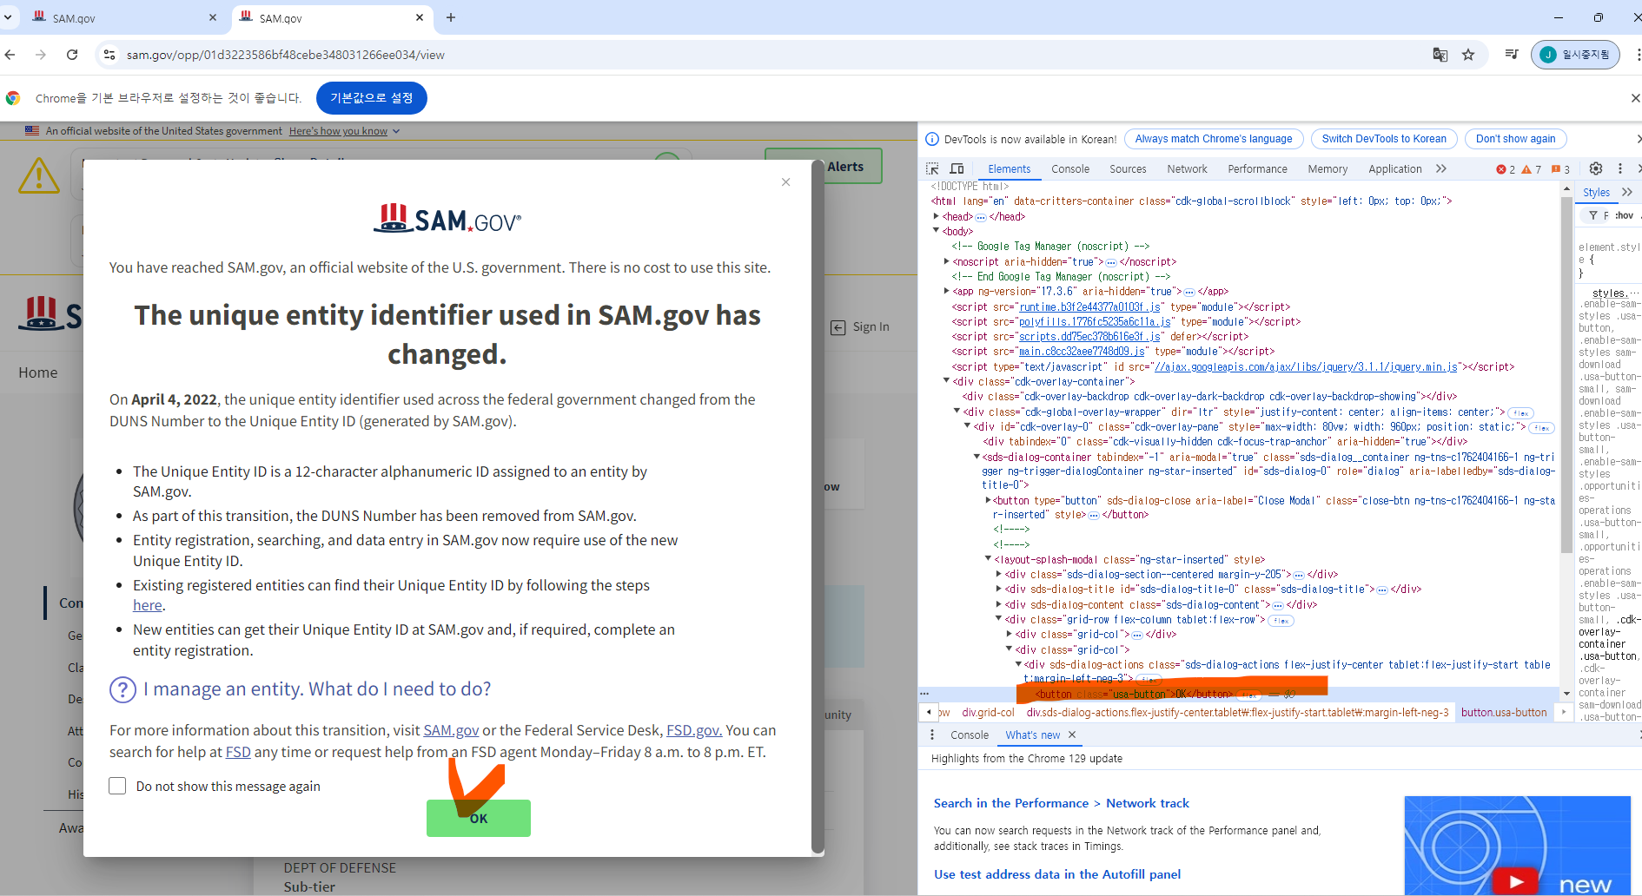
After getting all the details by web scraping using Selenium, all the details are stored in a result dictionary.
And you can find the specific ‘GetDetails’ information from here.
Define ‘GetDetails’ function to web scrape data by using Selenium.
Provide ‘url’ info, retrieved by API call, to access each RPF.
Wait until all web elements on the web page have loaded for 3 seconds.
When accessing the first RFP, a small pop up window appears.
Find the path of the ‘OK’ button in a DevTools, copy the ‘XPATH’ of it and execute ‘click’ action to close the window.
However, when accessing the 2nd RFP on the same window, I found that no more pop-ups appeared. I added ‘except’ command to avoid any error when a button is not found.
‘버튼없다’ means ‘no button’.

Slide 20
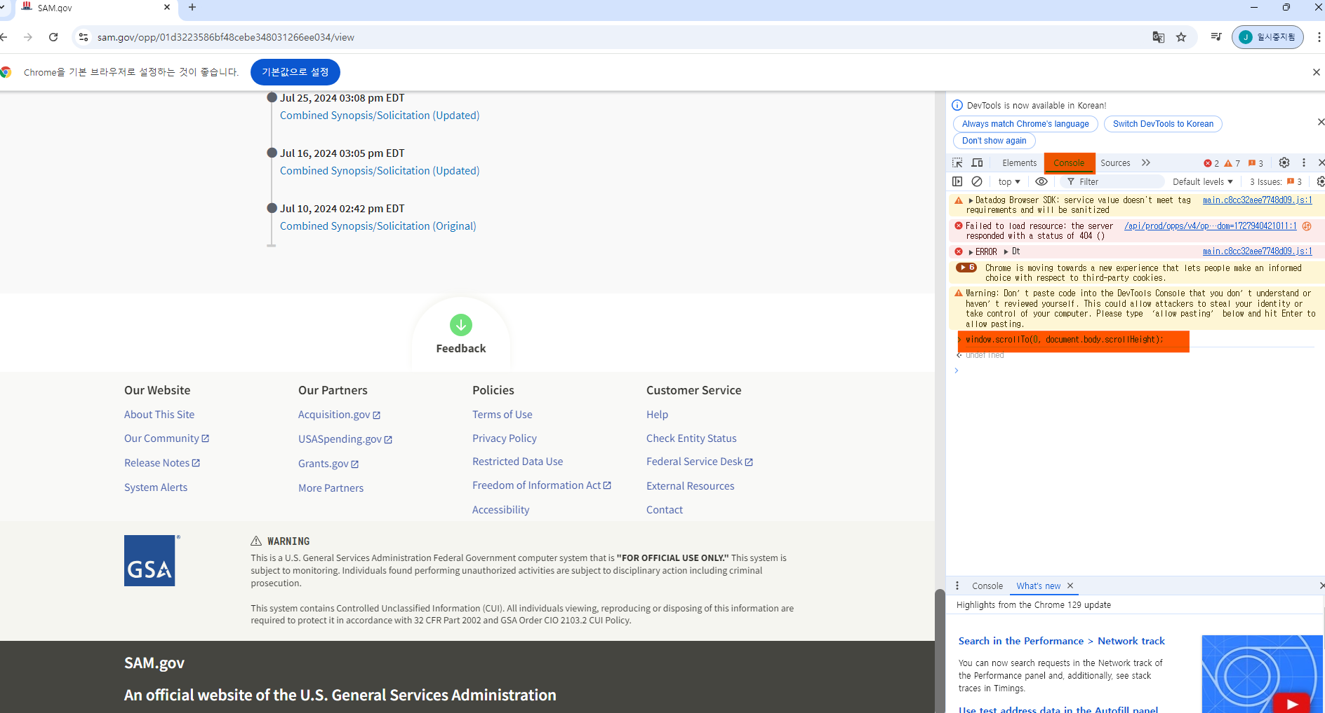
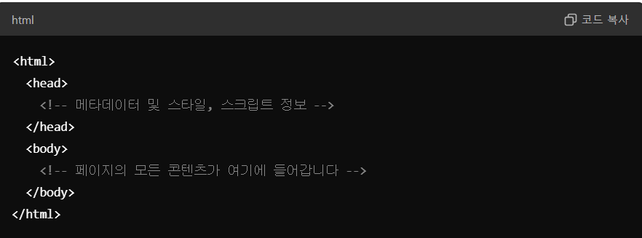
The ‘execute.script’ function is used in Selenium to execute JavaScript commands for controlling dynamic actions like scrolling.
The function controls dynamic actions like scrolling down to the very bottom part.
You can input "window.scrollTo(0, document.body.scrollHeight);” command in the Console of the DevTools to check whether or not it works.
‘find_element’ is used to find elements like text and images on the webpage. Here, you can find a ‘body’ tag using ‘By’ and then send a key ‘Page up’ to scroll up to the very top.
<head> is one of the tags in the HTML of the web page, indicating the whole web page where texts, images, links and buttons are placed.

Slide 21
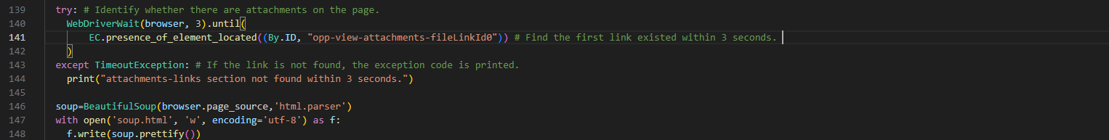
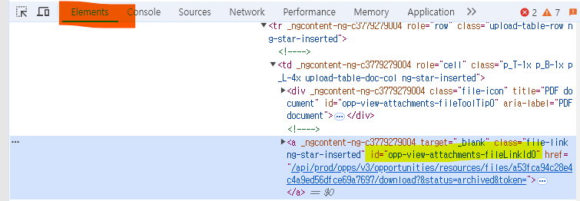
The try-except command is used to let the browser pause for at least 3 seconds to find the first link of attachments located on the web page within an <a> (anchor) tag that includes the ‘id’ element for the first link.
I used ‘Beautifulsoup’ for web scraping while controlling the Chrome browser using Selenium.
In the ‘Beautifulsoup’ library, ‘html.parser’ function can be used to scrape the entire HTML source code of the loaded web page.
Browser.page_source indicates the entire HTML source code of the loaded web page.
The HTML source code is stored in a ‘soup’ object as soup.html, and made well-organized using the ‘prettify’ function.

Slide 22
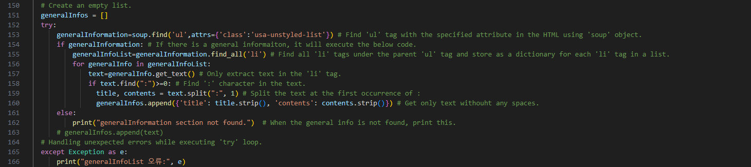
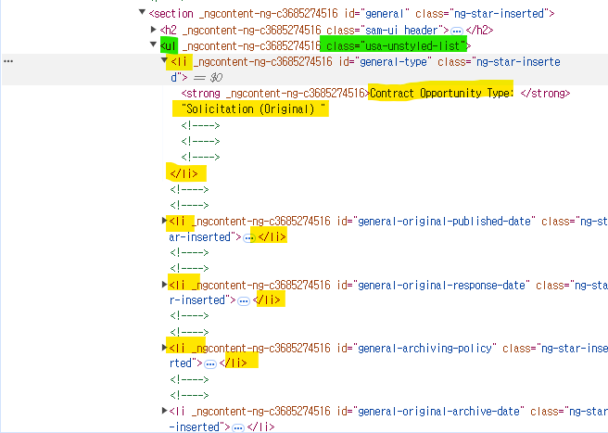
From now on, I am going to web scrape every detail for each RFP using ‘beautifulsoup’.
Find ‘ul’ (unordered list) tags in the HTML structure which includes ‘General Information’ details on the web page, and store them in ‘generalInformation’ object.
Under the ‘ul’ tags, find all ‘li’ tags which are the child tags of the ‘ul’ tag and store them in ‘generalInfoList’.
Under the ‘li’ tag, there is text data which consists of the exact details for web scraping.
Find ‘:’ in the text and split the text based on the character and store them in a dictionary.
Add all dictionaries to the ‘generalInfos’ List.

Slide 23
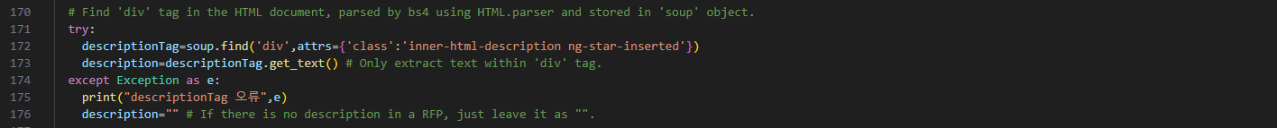
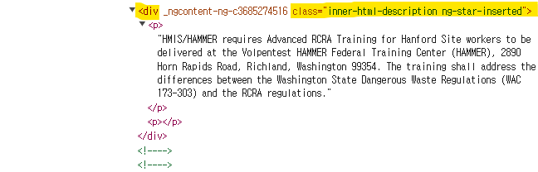
Find ‘div’ tag with ‘class’ element equal to ‘inner-html-description ng-star-inserted.’ that contains all details in ‘description’ for each RFP, and store them in ‘descriptiontag’ object.
Under the ‘div’ tag, there is the exact description details that we need to web scrape.
Use ‘get_text’ function.
If there is no description details on a specific RFP, leave it as a blank with an empty string (“”).

Slide 24
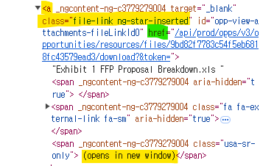
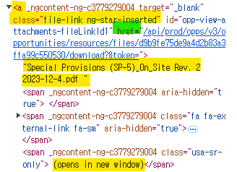
First File
Second File
Find the ‘a’ (anchor) tag with class ‘file-link-ng-star-inserted’ and store the HTML structure into the ‘fileLinks’ object.
There will be multiple <a> tags with the same class if there are several attachments on a specific RFP.
In each file link of a specific RFP, extract the ‘href’ key to combine it with the base URL.
Extract the title using ‘get.text’ function and remove unnecessary text such as “(opens in new window)” by replacing it with an empty string “”.

Slide 25
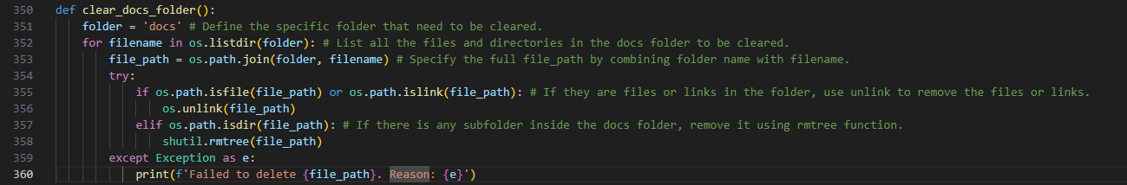
Create a new ‘docs’ folder in your current directory where the script is running.
If the ‘docs’ folder does not exist in the current directory, it creates a new folder.
It sends an API call to get each file downloaded into the newly created ‘docs’ folder. Then the files are stored in the ‘response’ object.
In the ‘docs’ folder, there will be downloaded files, and in the back end, the ‘file’ handler opens each file and writes the content in a binary format.
After getting details from the web page and uploading all the details to Supabase, delete the files downloaded into the ‘docs’ folder to avoid any capacity issue.

Slide 26
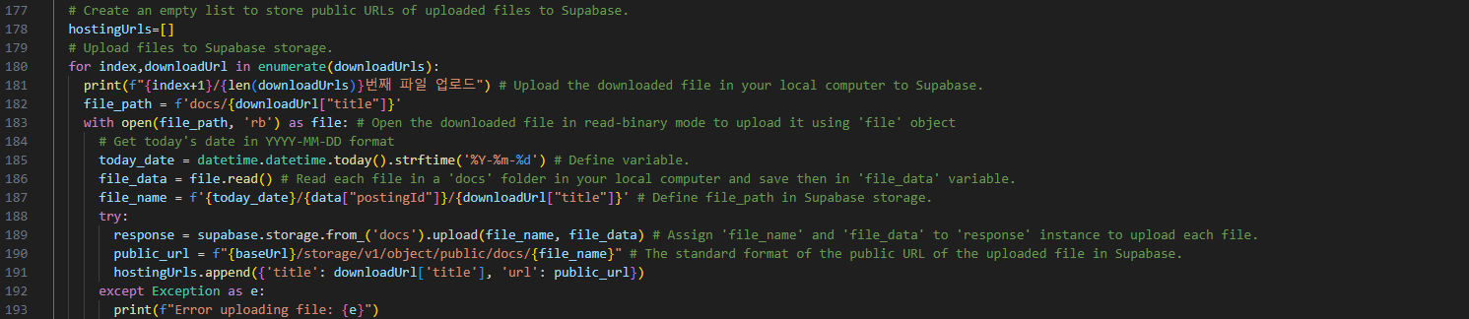
‘hostingURLs’ are used to upload the downloaded files to Supabase and retrieve these files from Supabase.
‘번째 파일 업로드’ translates to ‘uploading the downloaded files.’
Open the downloaded files in read-binary mode using the ‘file’ handler.
Specify the file path in the ‘storage’ of Supabase.
I have already created a new ‘docs’ bucket in Supabase and read all the file data stored in the ‘docs’ folder on my local computer.
The public URL is the same as the hostingURL that is used in Supabase when downloading the files.

Slide 27
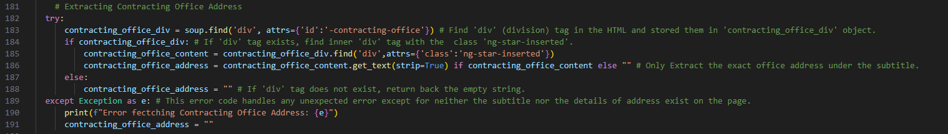
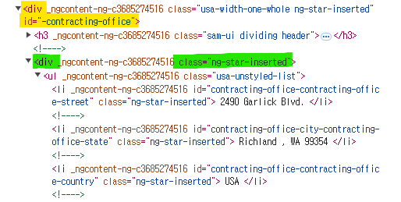
Find the ‘div’ tag in the HTML of the web page with the ‘id’ attribute set to ‘-contracting-office’ and store it in the ‘contracting_office_div’ object.
After retrieving the HTML structure, find another ‘div’ tag with the class ‘ng-star-inserted’ that contains the contact address details.
If a sub ‘div’ tag under the main tag exists, use the ‘get_text’ function to retrieve the address details.

Slide 28
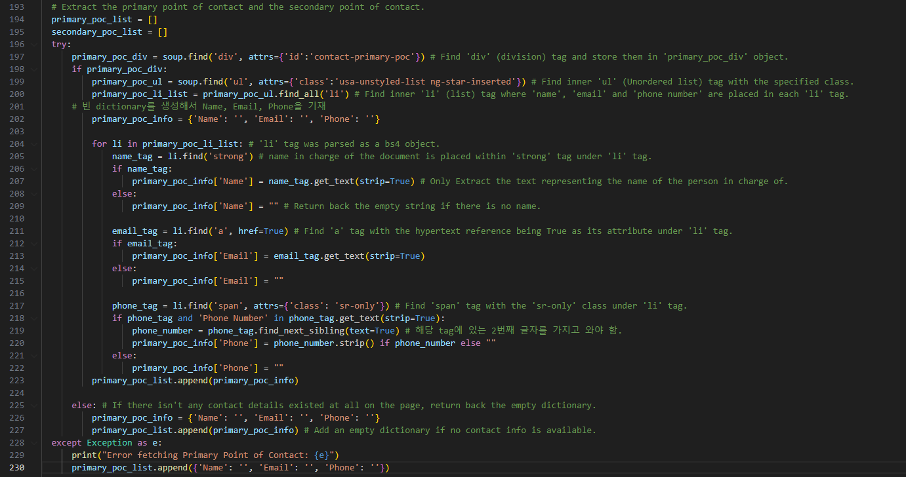
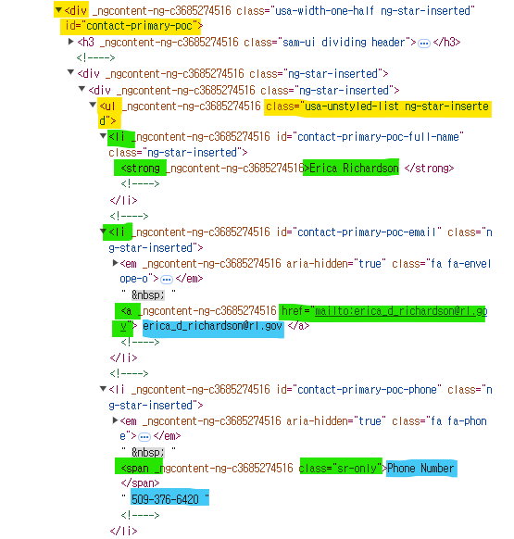
Find all tag details necessary for web scraping the point of contact details.

Slide 29
Find the ‘div’ tag with the ‘id’ attribute set to ‘contact-primary-poc’ which contains the text details of the primary point of contact.
If this tag exists, find the ‘ul’ tag with the ‘class’ attribute set to ‘usa-unstyled-list ng-star-inserted’.
Under the ‘ul’ tag, find all ‘li’ sub tags that contain ‘Name’, ‘Email’ and ‘Phone number’.
For the ‘strong’ tag under the ‘li’ tag, store the HTML structure of the ‘strong’ tag and retrieve the ‘Name’ text using the get_text function.
For the ‘a’ tag under another ‘li’ tag with a hypertext reference, store the HTML structure of the ‘a’ tag in the ‘email-tag’ object and retrieve only the email text.
For the ‘span’ tag under another ‘li’ tag, there are two text elements: ‘Phone Number’ and the actual number. Extract the second text, which is the real phone number by using ‘find_next_sibling’ function.
Store all the details in a ‘primary_poc_info’ dictionary and append them into a ‘primary_poc_list’ list (already defined before the try loop).
If no primary contact details are found, leave the fields as empty strings.

Slide 30
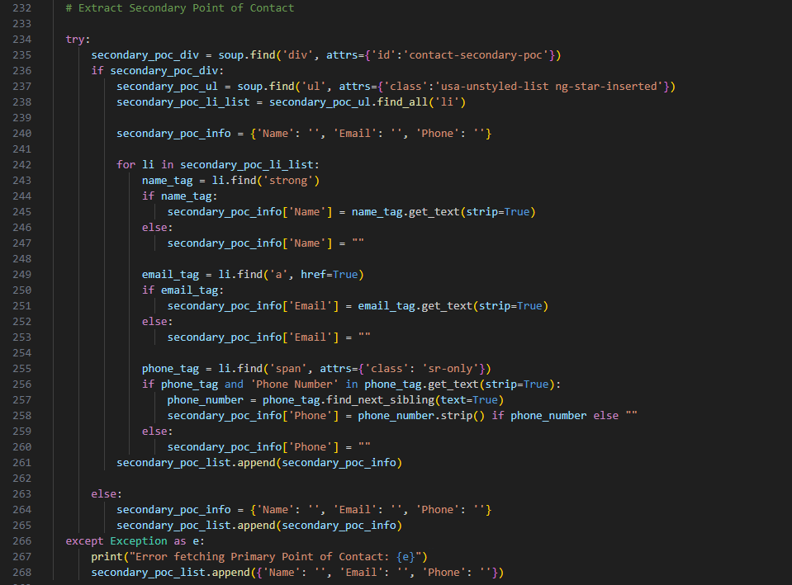
The same method used for scraping the primary point of contact was used for the secondary point of contact.

Slide 31
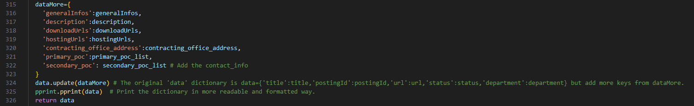
Create a ‘dataMore’ dictionary to store all retrieved data and update the existing ‘data’ extracted by sending an API call, for example: data={'title':title,'postingId':postingId,'url':url,'status':status,'department':department}.
2. Print the updated data in a structured way using a ‘pprint’ function.

Slide 32
Part 3. Upload data to Supabase by sending an API call.

Slide 33
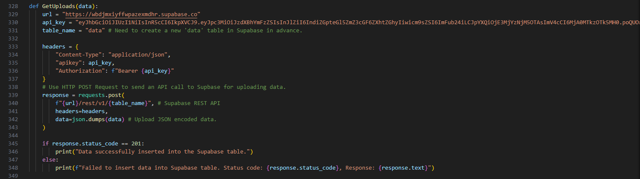
Define ‘GetUploads’ function in Python to send an API call to the Supabase REST API.
The ‘GetUploads’ function can send the API call by using an HTTP POST request.
If the ‘data’ is successfully uploaded, then ‘Data Successfully inserted into the Supabase table.’ is printed.
After the successful insertion, the program will proceed to the next iteration to extract and upload additional data.

Slide 34
Appendix. The outcomes shown on the terminal of VS CODE when running the Python script.

Slide 35
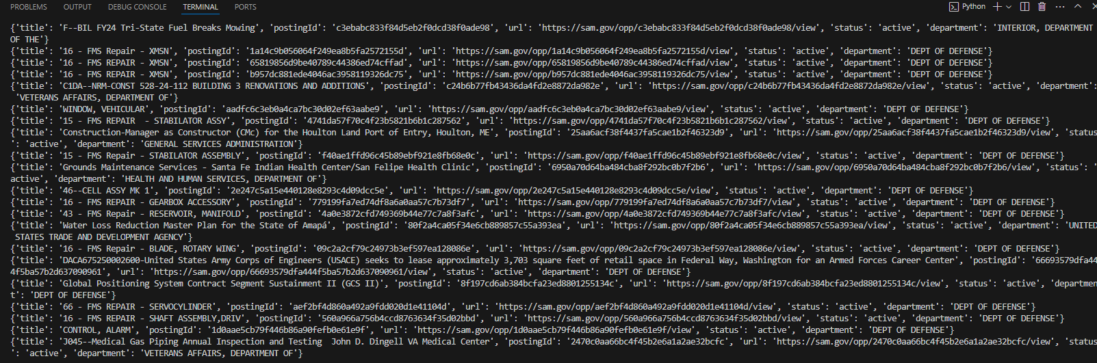

Slide 36
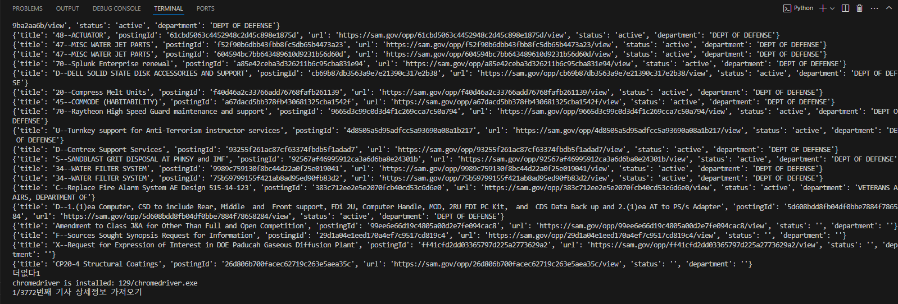

Slide 37
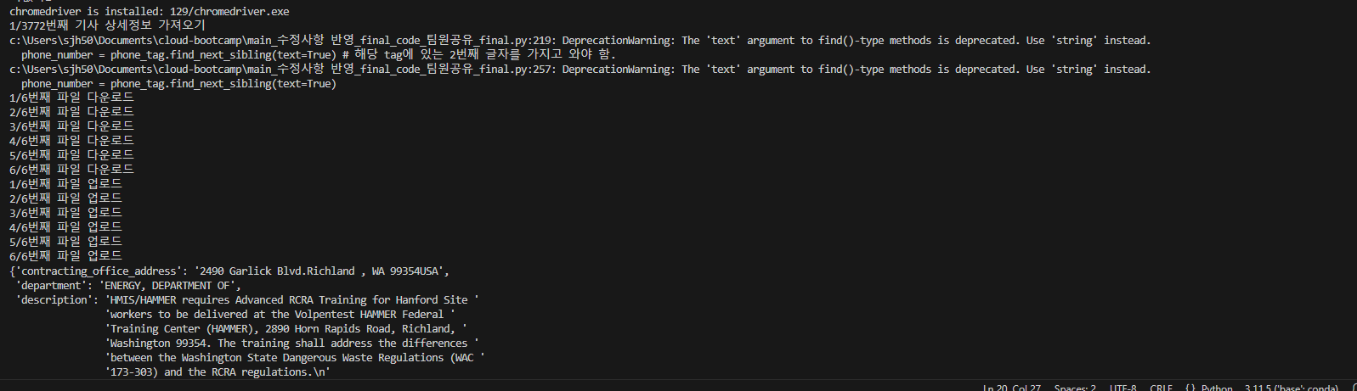

Slide 38
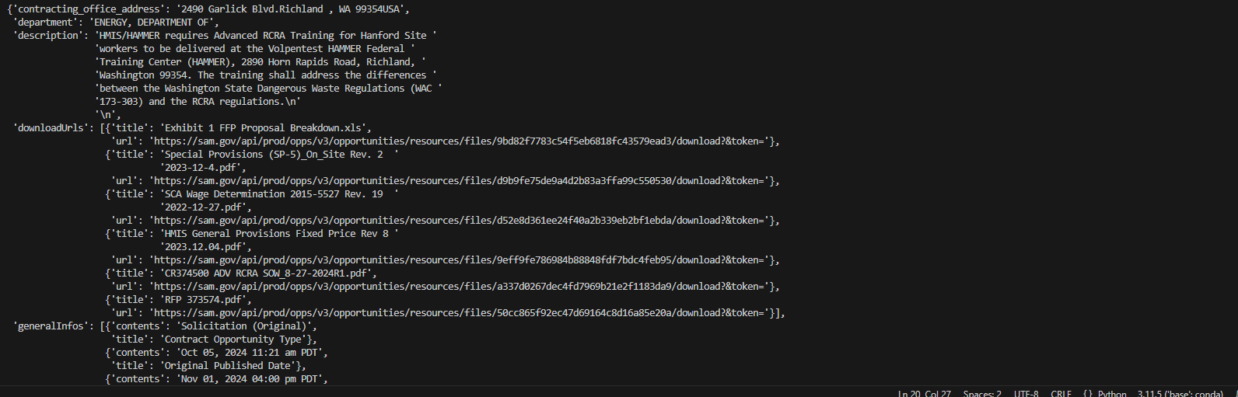

Slide 39
